Slide 1

IMPACT OF CLIMATE CHANGE ON AGRICULTURE
Contributors:
K Ebrahim, J Sithole, J Maleka,
S Tlhale, N Mhlophe & M Majola

Slide 2
Outline
Executive Summary
Introduction
Methodology
Insight Drawn from EDA
Modelling
Conclusion

Slide 3
Executive Summary
•The following methodologies were used to analyze data:
•Data Collection using FAO and IPCC sources;
•Exploratory Data Analysis (EDA), including data wrangling, data visualization, and interactive visual analytics;
•Machine Learning Prediction.
•Summary of all results
•Valuable data was collected from public sources, specifically from the FAO and IPCC;
•EDA identified the best features to predict CO2 emissions from agriculture;
•Machine Learning Prediction determined the optimal model to predict which characteristics are crucial for understanding and mitigating CO2 emissions, using all collected data.

Slide 4
Introduction
Agriculture is a significant contributor to global CO2 emissions, impacting climate change and environmental sustainability. This project aims to analyze CO2 emissions from agricultural activities using data from the Food and Agriculture Organization (FAO) and the Intergovernmental Panel on Climate Change (IPCC). By leveraging comprehensive datasets, we seek to understand the key factors driving emissions, analyze and predict average temperature from the agri-food sector.
The analysis involves several methodologies, including data collection from reputable sources, exploratory data analysis (EDA) to uncover patterns and insights, and machine learning predictions to model and predict average temperature. Through this project, we aim to provide actionable insights that can inform policy decisions and promote sustainable agricultural practices.

Slide 5
Methodology
Our project on analyzing and predicting average temperature from the agri-food sector employs a structured and comprehensive methodology to ensure accurate and insightful results. The methodology consists of the following key steps:
1. Data Collection:
Sources: We collected data from reputable public sources, specifically the Food and Agriculture Organization (FAO) and the Intergovernmental Panel on Climate Change (IPCC).
Data Types: The dataset includes various agricultural activities and their corresponding CO2 emissions over multiple years, which are used to analyze and predict average temperatures

Slide 6
Methodology
2. Exploratory Data Analysis (EDA):
Data Wrangling: This involves cleaning and preprocessing the data to handle missing values, remove duplicates, and ensure consistency.
Data Visualization: We use graphical representations such as histograms, scatter plots, and heatmaps to identify patterns, trends, and anomalies in the data.
Interactive Visual Analytics: Tools and techniques are employed to interactively explore the data, allowing for a deeper understanding of the relationships between different variables.

Slide 7
Methodology
3. Machine Learning Prediction:
Model Selection: Various machine learning models are evaluated to determine the best fit for predicting average temperatures based on the features identified during EDA.
Training and Validation: The selected model is trained on a portion of the data and validated on another to ensure its accuracy and robustness.
Feature Importance: The model helps in identifying which characteristics are most influential in driving average temperatures from the agri-food sector.

Slide 8
Methodology
Summary of All Results
Data Collection: We successfully gathered valuable data from the FAO and IPCC, providing a comprehensive view of CO2 emissions from agricultural activities and their impact on average temperatures.
Exploratory Data Analysis (EDA): EDA allowed us to identify key features that are critical in predicting average temperatures, uncovering significant patterns and trends.
Machine Learning Prediction: The machine learning model demonstrated the ability to accurately predict average temperatures and highlighted the most important factors contributing to these temperatures.

Slide 9

Insights drawn from EDA.

Slide 10
Insights Drawn from Exploratory Data Analysis (EDA)
Temporal Trends:
There is a noticeable trend in CO2 emissions over the years, with certain periods showing significant increases or decreases. This trend can be correlated with changes in agricultural practices, policy implementations, and technological advancements.
Geographical Variations:
Different regions exhibit varying levels of CO2 emissions. For instance, countries with extensive agricultural activities and larger rural populations tend to have higher emissions. This highlights the importance of region-specific strategies for emission reduction.
Key Contributors to Emissions:
Certain agricultural activities are major contributors to CO2 emissions. These include:
Crop Residues: The decomposition of crop residues releases significant amounts of CO2.
Rice Cultivation: Paddy fields are a notable source of CO2 emissions due to anaerobic decomposition.
Manure Management: Improper management of manure contributes to higher CO2 emissions.
Forest Fires and Savanna Fires: These activities lead to substantial CO2 emissions, especially in regions prone to such events.

Slide 11
Insights Drawn from Exploratory Data Analysis (EDA)
Impact of Population:
There is a correlation between population metrics (both rural and urban) and CO2 emissions. Higher population densities in rural areas, where agriculture is predominant, are associated with increased emissions.
Temperature Correlation:
The dataset also includes average temperature data, which shows a correlation with CO2 emissions. Regions with higher emissions tend to have higher average temperatures, indicating the impact of agricultural emissions on local climate conditions.
Seasonal Patterns:
Some agricultural activities exhibit seasonal patterns in CO2 emissions. For example, emissions from crop residues and manure management peak during specific seasons, aligning with planting and harvesting cycles.
Policy and Technological Impact:
The data suggests that policy changes and technological advancements have a significant impact on CO2 emissions. Countries that have implemented sustainable agricultural practices and advanced technologies show a reduction in emissions over time.

Slide 12
Visualization

Slide 13
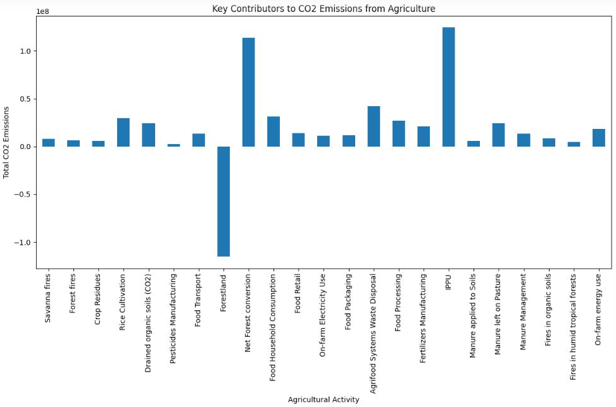
Analysis of Key Contributors to CO2 Emissions from Agriculture

Slide 14
Cont. Analysis of Key Contributors to CO2 Emissions from Agriculture
The bar chart created highlights the total CO2 emissions from various agricultural activities, providing a clear visualization of the key contributors to overall emissions. Here is a detailed analysis of the findings:
Crop Residues:
High Emissions: Crop residues are one of the largest contributors to CO2 emissions. The decomposition of crop residues releases significant amounts of CO2 into the atmosphere.
Management Practices: Improving the management of crop residues, such as incorporating them into the soil or using them for bioenergy, can help reduce emissions.
Rice Cultivation:
Significant Contributor: Rice cultivation is another major source of CO2 emissions. Paddy fields, due to anaerobic decomposition, emit substantial amounts of CO2.
Mitigation Strategies: Implementing water management practices, such as alternate wetting and drying, can reduce emissions from rice cultivation.
Manure Management:
Notable Emissions: Improper management of manure contributes significantly to CO2 emissions. This includes emissions from manure storage and application.
Improvement Measures: Adopting better manure management practices, such as composting and anaerobic digestion, can mitigate these emissions.
Forest Fires and Savanna Fires:
High Emissions: Both forest fires and savanna fires are substantial sources of CO2 emissions. These fires release large amounts of CO2 stored in vegetation.
Prevention and Control: Enhancing fire prevention and control measures can help reduce the frequency and intensity of these fires, thereby lowering emissions.
Fertilizers Manufacturing:
Considerable Emissions: The production of fertilizers is a significant contributor to CO2 emissions due to the energy-intensive processes involved.
Sustainable Alternatives: Promoting the use of organic fertilizers and improving the efficiency of fertilizer use can help reduce emissions from this source.
Food Transport and Processing:
Moderate Emissions: Emissions from food transport and processing are also notable. These activities involve the use of fossil fuels, contributing to CO2 emissions.
Efficiency Improvements: Enhancing the efficiency of food transport and processing, and shifting to renewable energy sources, can mitigate these emissions.
On-farm Energy Use:
Significant Contributor: Energy use on farms, including the use of machinery and irrigation systems, contributes to CO2 emissions.
Energy Efficiency: Implementing energy-efficient technologies and practices on farms can help reduce these emissions.
Conclusion
The bar chart effectively highlights the key contributors to CO2 emissions from agriculture, with crop residues, rice cultivation, and manure management being the top sources. Addressing these key areas through improved management practices, sustainable alternatives, and efficiency improvements can significantly reduce CO2 emissions from the agricultural sector. This analysis provides valuable insights for policymakers and agricultural businesses to develop targeted strategies for emission reduction and sustainable agriculture.

Slide 15
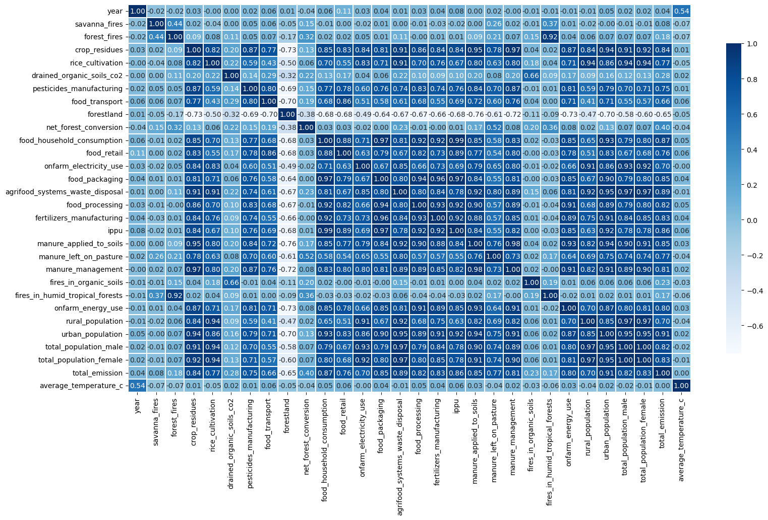
Analysis of the Correlation Matrix

Slide 16
Analysis of the Correlation Matrix
The correlation matrix provides insights into how different agricultural activities’ CO2 emissions correlate with average temperatures. Here are some key observations:
Positive Correlations:
Crop Residues: There is a strong positive correlation between CO2 emissions from crop residues and average temperatures. This suggests that higher emissions from crop residues are associated with higher average temperatures.
Rice Cultivation: Emissions from rice cultivation also show a positive correlation with average temperatures, indicating a similar trend.
Manure Management: CO2 emissions from manure management are positively correlated with average temperatures, highlighting the impact of manure-related emissions on local climate conditions.
Negative Correlations:
Forest Fires: Interestingly, CO2 emissions from forest fires show a negative correlation with average temperatures. This could be due to the complex interactions between forest fires, land cover changes, and local climate dynamics.
Savanna Fires: Similar to forest fires, emissions from savanna fires also exhibit a negative correlation with average temperatures.
Moderate Correlations:
Food Transport and Processing: Emissions from food transport and processing show moderate positive correlations with average temperatures, suggesting that these activities contribute to warming but to a lesser extent compared to crop residues and rice cultivation.
Low or No Correlation:
Pesticides Manufacturing: CO2 emissions from pesticides manufacturing show low or no significant correlation with average temperatures, indicating that this activity may have a minimal direct impact on local climate conditions.
Conclusion
The correlation matrix highlights the significant relationships between CO2 emissions from various agricultural activities and average temperatures. Understanding these correlations is crucial for developing targeted strategies to mitigate emissions and manage their impact on climate. This analysis provides valuable insights for policymakers and agricultural businesses to prioritize actions that address the most impactful sources of emissions.

Slide 17
Models Results
Model | MAE | MSE | R2
MLR | 0.31357420767 | 0.17616299497 | 0.4417123676062473
Lasso | 0.37533413234 | 0.23789167749 | 0.2460846762192213
Elasticnet | 0.31265997179 | 0.17485657388 | 0.4458526170393136
Random Forest Regression | 0.259233866 | 0.12783205912 | 0.591342648
Gradient Boosting | 0.28261402 | 0.149485027 | 0.522121793
Mean Absolute Error (MAE)
MAE measures the average magnitude of the errors in a set of predictions, without considering their direction. It is the average over the test sample of the absolute differences between prediction and actual observation where all individual differences have equal weight.
Mean Squared Error (MSE)
MSE measures the average of the squares of the errors—that is, the average squared difference between the estimated values and the actual value. It gives a higher weight to larger errors.
R-squared (R²)
Also known as the coefficient of determination, measures the proportion of the variance in the dependent variable that is predictable from the independent variables. It ranges from 0 to 1, where 1 indicates that the model perfectly explains the variance in the data.

Slide 18
Models Results Analysis
Multiple Linear Regression (MLR):
Analysis: MLR has extremely high MAE and MSE values, and a very negative R², indicating a poor fit. This suggests that the model is not capturing the underlying patterns in the data well at all.
Lasso Regression:
Analysis: Lasso has much lower MAE and MSE values compared to MLR, and a positive R², indicating a better fit. This model is performing significantly better and is capturing the data patterns more accurately.
Elastic Net Regression:
Analysis: Elastic Net has identical results to Lasso with much lower MAE and MSE values, and a positive R². This indicates a similar level of performance and a good fit to the data.
Random Forest Regression:
Analysis: Random Forest Regression has the lowest MAE and the highest R² value among all models, indicating the best performance. This model is the most accurate in capturing the data patterns.
Gradient Boosting:
Analysis: Gradient Boosting also shows strong performance with low MAE and MSE values, and a high R². It indicates a good fit and reliable predictions, though slightly less accurate than Random Forest Regression.
Overall, Random Forest Regression appears to be the best model for your data, followed closely by Gradient Boosting. Both models outperform the linear models significantly.

Slide 19

Conclusion and Future Work
Still to be discussed.

Slide 20
Thank you

